Slide 1
THE DELHI PERSPECTIVE
Opening a restaurant in Delhi
By: AMIT KUMAR BEURA

Slide 2
Table of Contents
Introduction
Data collection and preparation
Data visualization
FoursquareAPI
Clustering
Results
Discussion and Conclusion

Slide 3
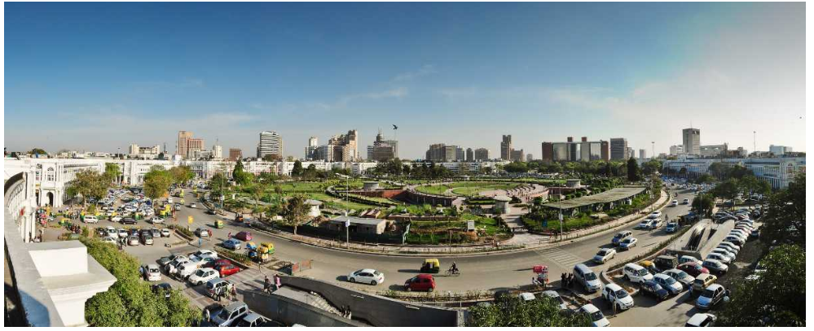
Introduction
Delhi is the capital city of India and is known as the “Heart of the Nation”.
It has a population of 11 million and metropolitan population of 16.3million.This makes city the second most populous city in India. It covers an area of 573 square miles (1,480 km). Speaking about the variety of cuisines, one can easily get all variety of food items which will definitely follow their taste; all you have to do is to find out the right place. From a historic restaurant to a modernly outlined place serving the best food items are easy to find in India’s Capital Territory.

Slide 4
Business problem and Discussion of Background
With such huge population and people from all of the country of different culture, one find its difficult to decide as where to open a restaurant. In the Delhi Perspective, we will try to find out some of the issues listed below:
1. Which areas are more populated.
2. Comparing the different areas of Delhi.
3. The most Suitable location of having Restaurant.
4. The area which has the maximum number of restaurants.
All the Businessmen who are ready to invest their money in opening restaurant
All the general public and the tourists who wants to change their taste and try out different cuisines.
The jobseekers who can easily find out the work in the busiest areas of Delhi
The Marketing people who can have their big impact on public using the information after comparing cities.
Beneficiaries

Slide 5
Data Collection and Data Preparation
1. Web scraping the data:
2. Data cleaning
We will basically use the data of Delhi contain districts of Delhi and other features like population, increase in population, density, etc which can be scraped from a website:
https://www.census2011.co.in/census/state/districtlist/delhi.html
The other website containing the sub districts or Headquarters of each district is obtained from the below website:
https://en.wikipedia.org/wiki/List_of_districts_of_Delhi .
After web scraping , the data is then cleaned by removing unnecessary rows and columns from the dataframe.
we will reset the index.
Both of the dataframes obtained from different websites are then merged on the district column.
We have completed the initial stage of obtaining a dataframe containing the districts , headquarters ,population ,density , sex-ratio , literacy and density

Slide 6
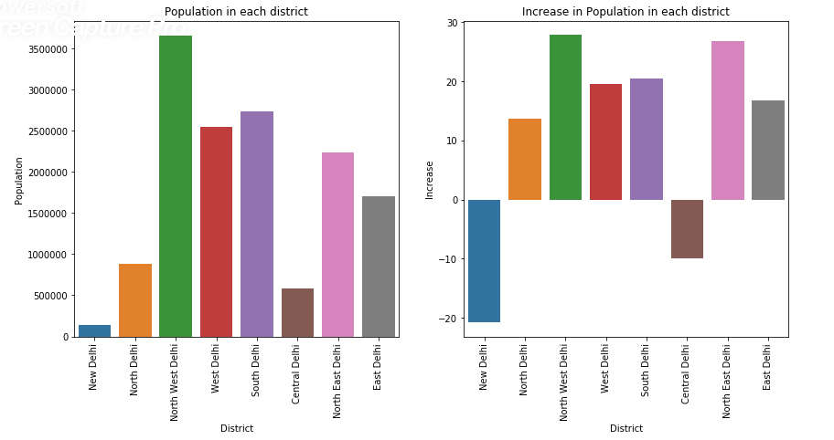
Data visualization
The features are analyzed using bar plots taken each of the districts and population, increase , sex ratio and density.
From both these plots, North-West delhi has highest population as well as increase in population having headquarters
At “Khanjawala”

Slide 7
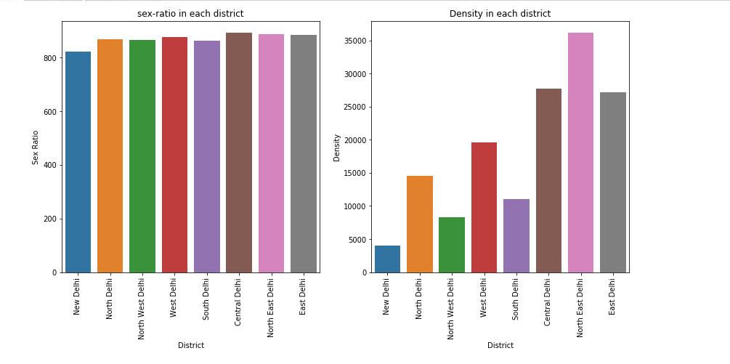
The sex-ratio is almost same in all districts while the density is maximum in North-east Delhi having its headquarters at “Nand-Nagri”

Slide 8
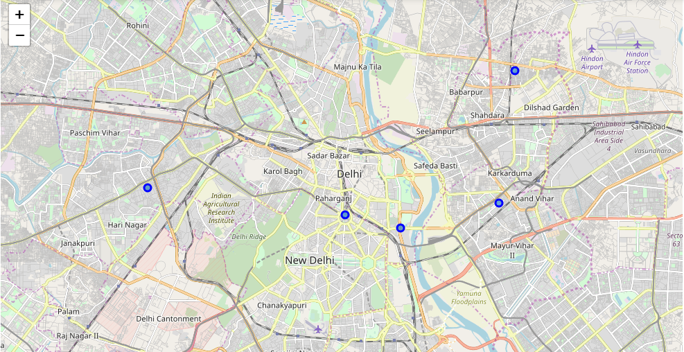
Map visualization
After getting the latitudes and longitudes of all the districts of Delhi using geocoder , we will superimpose all
The districts’ headquarters on folium map

Slide 9
Foursquare API
Using the Foursquare API we will try to get the 100 venues within a radius of 1000 meters.
SINGLE NEIGHBORHOOD
We’ve chosen the “Khanjawala” headquarter to get its venues as it has the highest population. But we found that there are no venues found in the area of 1km.
MULTIPLE NEIGHBORHOOD
So, we will take all districts’ Headquarters to find which neighborhood has maximum number of venues within 1000metres.
It was found that there are 77 unique venue categories found in the nearby headquarters of Delhi.
Lets only consider the restaurants in the venue category.

Slide 10
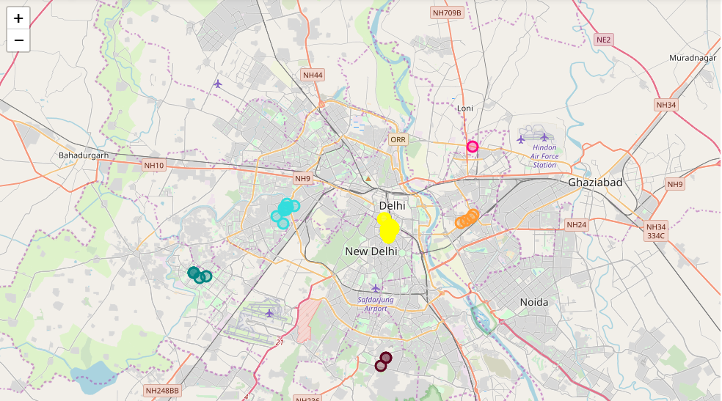
Restaurant in all districts

Slide 11
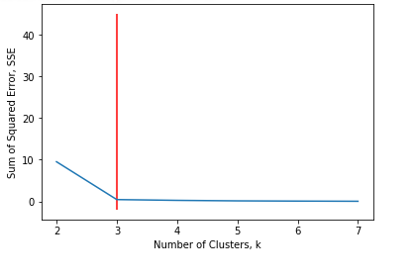
1. Elbow Method: The elbow method is used to solve the problem of selecting k
Clustering : kmeans
Optimal Number of Clusters for K-means
To get the optimal number of clusters to be used for the K-mean, there are a number ways possible for the evaluation. Therefore, in this task, the following are used:
1.Elbow (Criterion) Method
2.Silhouette Coefficient
2.Silhouette Coefficient:
To find the optimal value of the number of clusters, k, the number of clusters is
iterated corresponding Silhouette Coefficient’s calculated for each of the k-values used. The highest Silhouette Coefficient gives the best match to its own cluster.

Slide 12
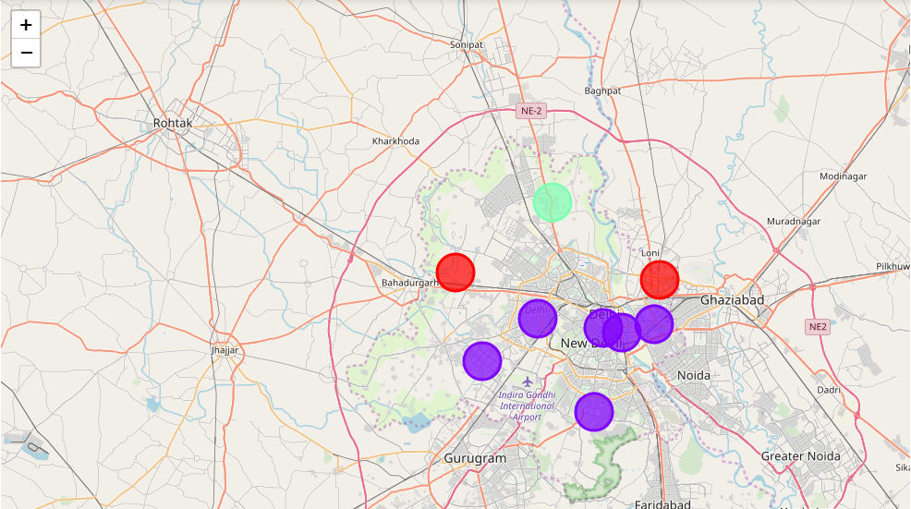
Clustering

Slide 13
The following are the highlights obtained from above 3 clusters and the data analysis:
It is surprising to know that despite being the most populated area of Delhi, we are not able to find any common venue near Kanjhawala.
2. Out of the all districts of Delhi, Indian Restaurant is found in the first venue category.
3. There are number of eating points in all districts than any other venues.
4. Although the clusters have variation, but the predominance of Indian restaurant was found 50%.
5. The number of Indian Restaurants were found at “Connaught Place”
Result

Slide 14
Discussion and Conclusion:
It will be beneficial to open a restaurant at Alipur , North Delhi as this will give least competition and does not have any restaurants nearby.
We were not able to find any venues nearby Khanjawala , the reason is that Khanjawala is a village and has very less amenities within 1kms.
Some drawback of these analyses is that clustering is done on only the most common venues which are obtained using four square location. Also, we have taken into consideration one city under each district .
Also the result can vary if we use other clustering techniques like DBSCAN.
In conclusion, this project would have had better results if there were more data in terms of crime data within the area, price of the land, traffic access and allowance of more venues exploration with the Foursquare (limited venues for free calls).Also, getting the ratings and feedbacks of the current restaurants within the clusters would have helped in providing more insight into the best location.

